Slide 1
Web 2.0
Virtualization and Cloud Computing
Ms. Sarishma
Assistant Professor,
CSIT, GEU

Slide 2
Web 2.0 (also known as Participative (or Participatory)^{[1]} and Social Web)^{[2]} refers to websites that emphasize user-generated content, ease of use, participatory culture and interoperability (i.e., compatible with other products, systems, and devices) for end users. - Wikipedia
Web 2.0 is a relatively new term, having only come into popular use about twenty years ago, in 1999. It was first coined by Darcy DiNucci and then became popularized by Tim O’Reilly and Dale Doughtery at a conference in 2004.
Web 3.0 is referred as “semantic web” coined by Berners-Lee to refer to a web of content where the meaning can be processed by machines

Slide 3
Static content, with the perception of users as consumers of data.
"move from personal websites to blogs and blog site aggregation, from publishing to participation, from web content as the outcome of large up-front investment to an ongoing and interactive process, and from content management systems to links based on "tagging" website content using keywords (folksonomy).“
-Terry Flew (New Media) describing differences between Web 1.0 and Web 2.0

Slide 4
Characteristics
Static pages instead of dynamic HTML
Content provided from the server's filesystem instead of a relational database management system (RDBMS).
Pages built using Server Side Includes or Common Gateway Interface (CGI) instead of a web application written in a dynamic programming language such as Perl, PHP, Python or Ruby.
The use of HTML 3.2-era elements such as frames and tables to position and align elements on a page. These were often used in combination with spacer GIFs
Proprietary HTML extensions, such as the <blink> and <marquee> tags, introduced during the first browser war.
GIF buttons, graphics (typically 88×31 pixels in size) promoting web browsers, operating systems, text editors and various other products.
HTML forms sent via email.
Web 1.0 sites aren't interactive

Slide 5
Web 2.0
The term "Web 2.0" was coined by Darcy DiNucci, an information architecture consultant, in her January 1999 article "Fragmented Future":
“ The Web we know now, which loads into a browser window in essentially static screenfuls, is only an embryo of the Web to come. The first glimmerings of Web 2.0 are beginning to appear, and we are just starting to see how that embryo might develop. The Web will be understood not as screenfuls of text and graphics but as a transport mechanism, the ether through which interactivity happens. It will [...] appear on your computer screen, [...] on your TV set [...] your car dashboard [...] your cell phone [...] hand-held game machines [...] maybe even your microwave oven.

Slide 6
Web 2.0 has become characterized by applications that connect people and technologies that link data
The Internet makes it possible to access information from any Internet-connected device –
Web-based tools for collaboration – Web applications – Other technologies for sharing information
With online collaboration, users are both creators and modifiers of content, dynamic and customized information feeds, etc – Wikis – Social networking sites – Blogs – RSS feeds – Podcasting

Slide 7
Value of site increases with users and use (Amazon reviews by users is an example)
Organic user interface and mashups
Participation and ownership differences
Traditional Web sites are about publishing
Web 2.0 is about participation
Traditional Web site lock down all legal rights to content
Web 2.0 sites lock down only some rights

Slide 8
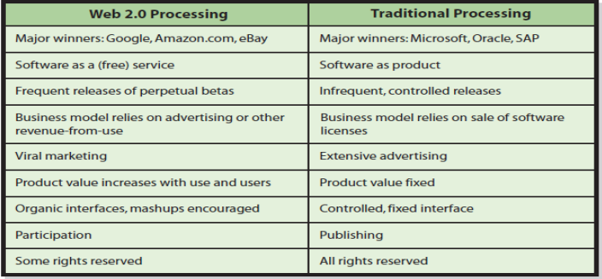

Slide 9
Key features
Folksonomy – free classification of information; allows users to collectively classify and find information (e.g. "tagging" of websites, images, videos or links)
Rich user experience – dynamic content that is responsive to user input (e.g., a user can "click" on an image to enlarge it or find out more information)
User participation – information flows two ways between the site owner and site users by means of evaluation, review, and online commenting. Site users also typically create user-generated content for others to see (e.g., Wikipedia, an online encyclopedia that anyone can write articles for or edit)
Software as a service (SaaS) – Web 2.0 sites developed APIs to allow automated usage, such as by a Web "app" (software application) or a mashup
Mass participation – near-universal web access leads to differentiation of concerns, from the traditional Internet user base (who tended to be hackers and computer hobbyists) to a wider variety of users

Slide 10
The client-side (Web browser) technologies used in Web 2.0 development include Ajax and JavaScript frameworks. Ajax programming uses JavaScript and the Document Object Model (DOM) to update selected regions of the page area without undergoing a full page reload.
New frameworks?

Slide 11
Web 2.0 can be described in 3 parts:
Rich Internet application (RIA) — defines the experience brought from desktop to browser, whether it is "rich" from a graphical point of view or a usability/interactivity or features point of view.
Web-oriented architecture (WOA) — defines how Web 2.0 applications expose their functionality so that other applications can leverage and integrate the functionality providing a set of much richer applications. Examples are feeds, RSS feeds, web services, mashups.
Social Web — defines how Web 2.0 websites tend to interact much more with the end user and make the end user an integral part of the website, either by adding his or her profile, adding comments on content, uploading new content, or adding user-generated content (e.g., personal digital photos).

Slide 12
SLATES by Andrew McAfee:
Search Finding information through keyword search.
Links to other websites Connects information sources together using the model of the Web.
Authoring The ability to create and update content leads to the collaborative work of many authors. Comment systems allow readers to contribute their viewpoints.
Tags Categorization of content by users adding "tags" — short, usually one-word or two-word descriptions — to facilitate searching.
Collections of tags created by many users within a single system may be referred to as "folksonomies" (i.e., folk taxonomies).
Extensions Software that makes the Web an application platform as well as a document server. Examples include Adobe Reader, Adobe Flash, Microsoft Silverlight, ActiveX, Oracle Java, QuickTime, and Windows Media.
Signals The use of syndication technology, such as RSS feeds to notify users of content changes.

Slide 13
APIs (Application Programming Interface)
Created by a company or organization that wishes to share its data with third-party applications.
By providing a well-documented, well-defined interface, third-party programmers can build applications and services that rely on that particular API specification.
By making APIs public, companies can gain a greater audience for their data or services
Third-party developers may, for example, develop applications that the API provider had never even thought of.
A good example of a company providing APIs is Amazon.com,
The benefits to Amazon are obvious, – thousands of third-party Web sites create new and interesting ways for Amazon products to be displayed and interacted with – something that would not be possible without such APIs being made available.

Slide 14
Mashups
Mashups are Web applications that combine content or data from multiple online sources into new Web applications
Contents are continually updated
Content for mashups often comes from Web feeds and Web services
Amazon uses mashup technologies to aggregate product descriptions with partner sites and user profiles, commentaries, and images.
Travel sites, such as Travelocity, Kayak, Matador, and Travature, integrate standard content (such as airfare search engines, travel guides, maps, and hotel reviews) with comments, ratings, and images from users.
Creating mashups usually requires significant Web development experience
Mapping mashups are the most popular type of mashup
HousingMaps.com Craigslist and MapQuest • SpotCrime.com – SpotCrime displays the locations of criminal incident reports on a Google Map to illustrate where crime takes place in a neighborhood.

Slide 15
Really Simple Syndication
RSS feed – provides frequently published and updated digital content on the Web
It is a family of web feed formats used to publish frequently updated works— – blog entries, news headlines, audio, and video—in a standardized format.
An RSS document includes full or summarized text, plus metadata such as publishing dates and authorship.
Web feeds benefit publishers by letting them syndicate content automatically.
They benefit readers who want to subscribe to timely updates from favored websites or to aggregate feeds from many sites into one place.
RSS feeds can be read using software called an "RSS reader", "feed reader", or "aggregator", which can be web-based, desktop-based, or mobile-device-based.
The user subscribes to a feed by entering into the reader the feed's URL or by clicking an RSS icon in a web browser that initiates the subscription process.
The RSS reader checks the user's subscribed feeds regularly for new work, downloads any updates that it finds, and provides a user interface to monitor and read the feeds.

Slide 16
User Generated Content (UGC)
Blogs, Wikis and Social Networking in Business
Reach out and market to potential new customers.
Facebook sites to market their product to specific groups on Facebook.
Support and give added value to existing customers.
A software company could have a blog that discusses in depth use of a software product.
Within their company to communicate between departments and share knowledge.

Slide 17
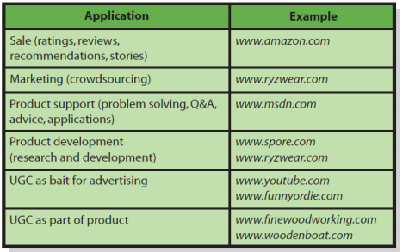
Types of UGC
Ratings and surveys
Opinions
Customer stories
Discussion groups
Wikis
Blogs
Video
Crowdsourcing

Slide 18
Web 3.0
Web 3.0 is the vision of the next generation of the Web in which all of the information available on the Web is woven together into a single experience.
The related movement called the Semantic Web is a collaborative effort to add a layer of meaning to existing information to reduce the amount of human time spent in searching and processing that information.
This potentially could have huge effects on businesses as simple analysis becomes mechanized, requiring fewer humans to perform this basic task.

Slide 19
